Slide 1

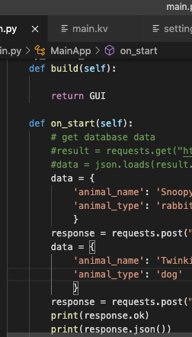
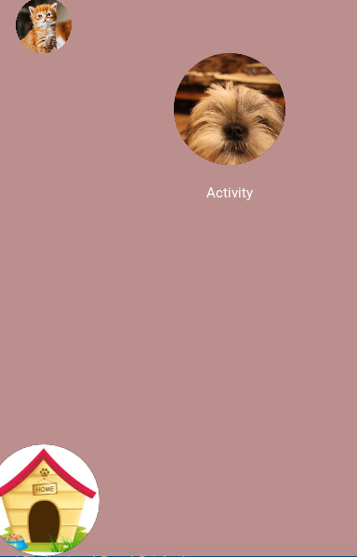
Lost and Found Pet App
Roxanna A. Lopez
The friendly app that helps you and others locate a lost pet.
https://github.com/ksu-hmi/Lost-and-Found-Pet-App

